Slide 1

Access Demystified
Does America Want You?
Notes:
Let’s Talk Visas

Slide 2
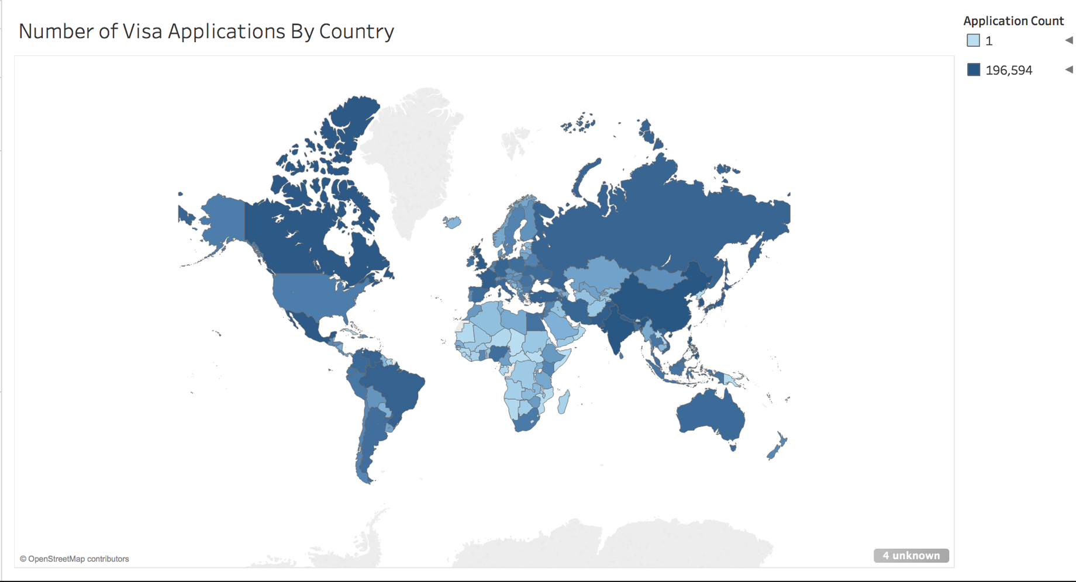
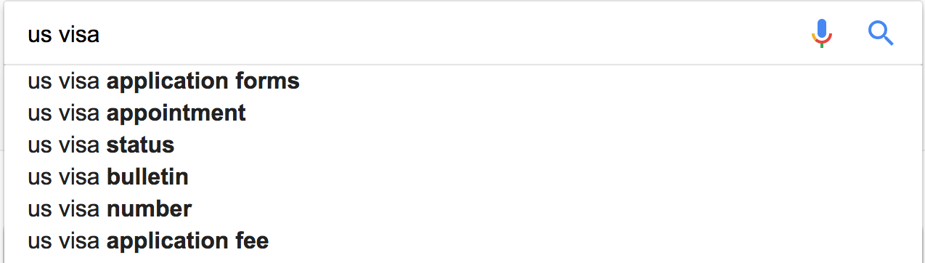
All Those People, All That Red Tape
Notes:
Getting a visa is confusing, as you can see from the chart
Getting a visa can also be challenging, my friends
Not surprising, chart shows just a small representation of the sheer variety of people that come in different numbers from different places
Is there a way that we can save time on all fronts, so that people who haven’t even started applying can find out whether or not they can get their visas?

Slide 3


2 “Representative” Cases
Person 1
Person 2
Notes:
So suppose we have these two people. They’re lazy, they don’t know half of the things that they need to for the visa apps, but they do know
What their main citizenship is
What city theyre from
What their latest degree is in
What state they are going to
What visa they are applying for
And what industry they are working in
Damien
NZ
Programmer
Doctorate
F-1
Wellington
-> California
Ka
Portugese
Healthcare
Masters
H1B
Macau
-> California

Slide 4
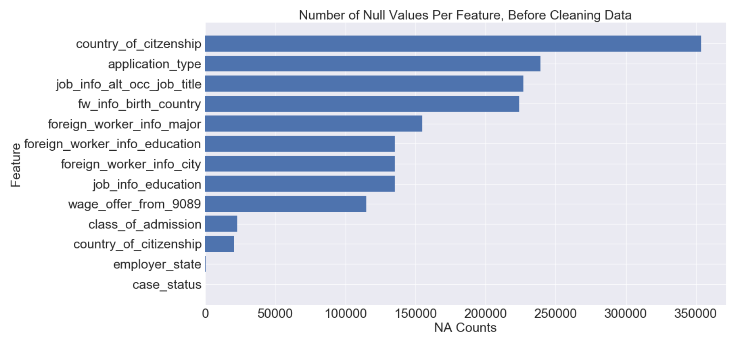
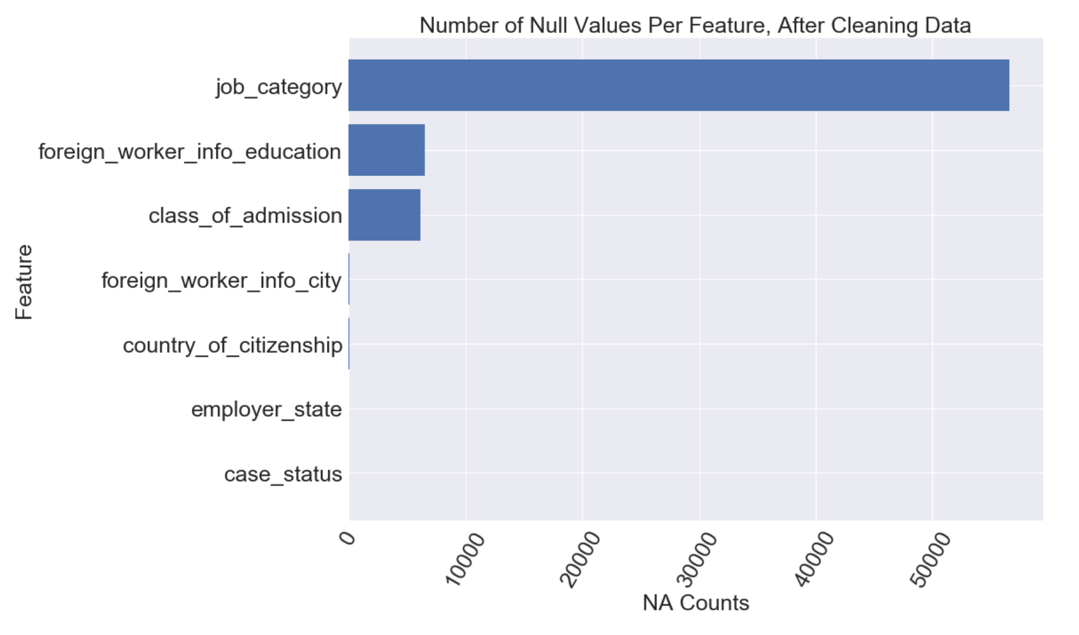
Data: Feature Selection
3 Datasets:
Kaggle Visa Dataset
Scraped:
City Population
State Abbreviations
Notes:
Before I say what the decision was, let me talk about how it was made
i started with a dataset with 150 classes of information about 300000 applications
Given the goal of making this process easy, feature selection was a
In order for people to be able to figure out their visa chances on their own, they need to know their own feature values, so I dropped the ones that weren’t intuitive (eg agent city)
Within the features that i did keep, there were still many na’s, and I read in two more web scraped datasets to assist with filling them.
I went about cleaning the other features using averages based on the values for each application in other columns
At the end, some columns, such as major, were captured by others, like job type, and so I dropped a few more. I also dropped those that didn’t appear to impact the final decision.

Slide 5
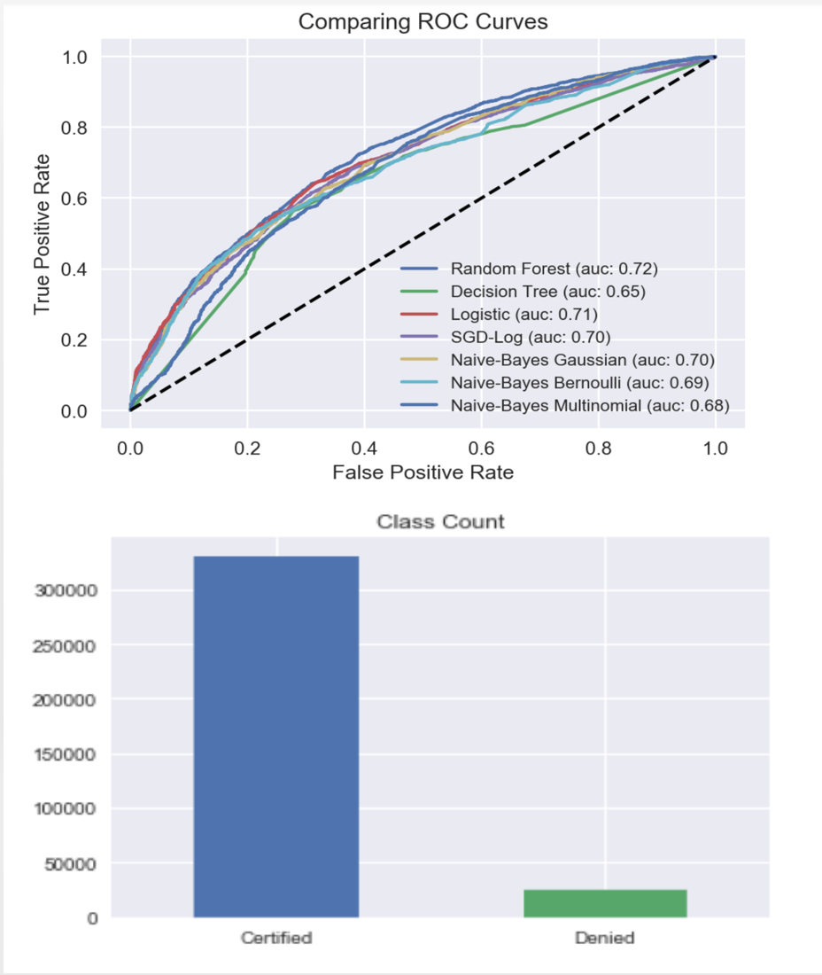
Modeling: Overview
Comparison Metric
Area under the Curve
Score
Train: 0.68
Test: 0.66
Notes:
After I cleaned the Data, I scaled it so I could run it through a few models.
I wanted to be agnostic about what metric to use, so I chose to maximizing the area under the curve to determine the best model and went with the Random Forest.
I’d also found that there was a huge disparity in the number of people who were certified and who were denied. I took a random sample of certified people of equal size to the number denied, because we’re more interested in what features lead to that difference.
Then I ran my model and popped it into flask app.
What is matrix and why chose it
Chose the one with the biggest area under the curve
You don’t know what you are going to optimize for, in general larger area under the curve means that over all combinations; both accuracy and precision are typically going to be better
One model might be better for you because you want to maximize accuracy
Agnostic about metrics- you don’t know what metric to use so you want a model with lots of options

Slide 6

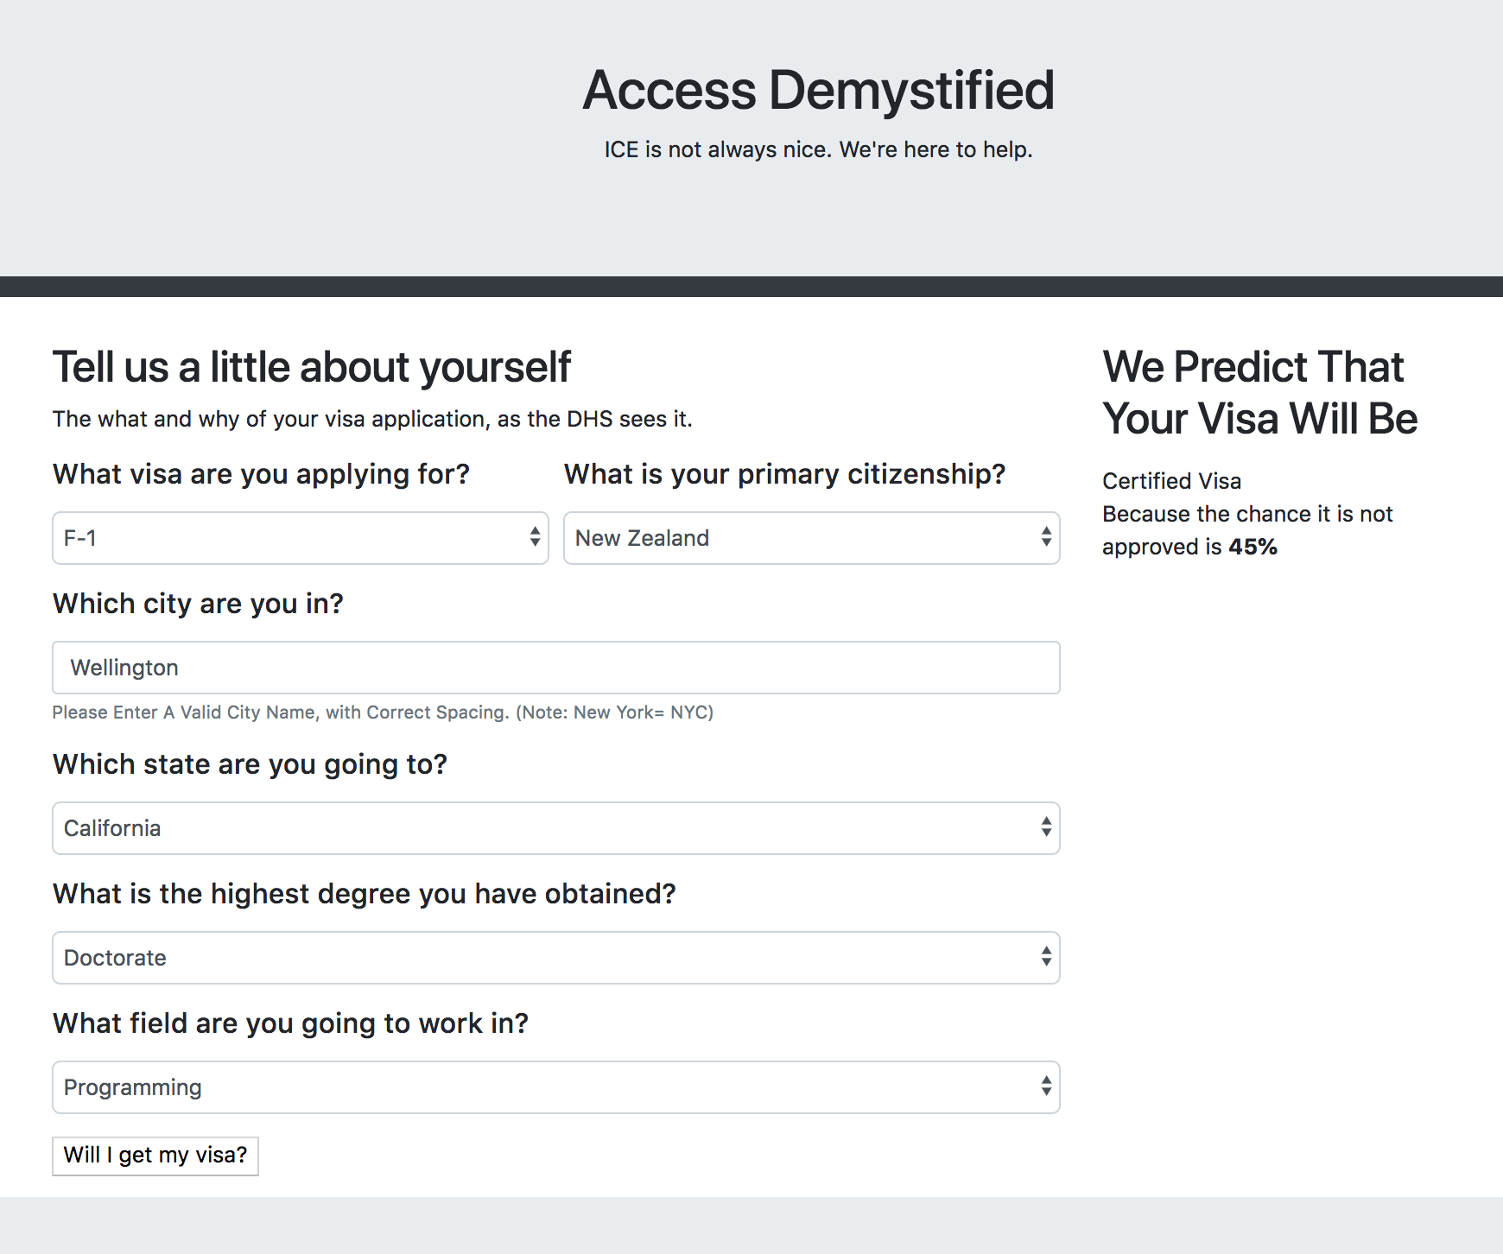

Results: Damien
Notes:
So here are our results for each person!
This app was designed to look like a typical online form, where the user either picks from a preset dropdown or fills in the needed info themselves (in the case of cities).
Their results get spit out on the right
Note that my model takes denied as the positive value.

Slide 7
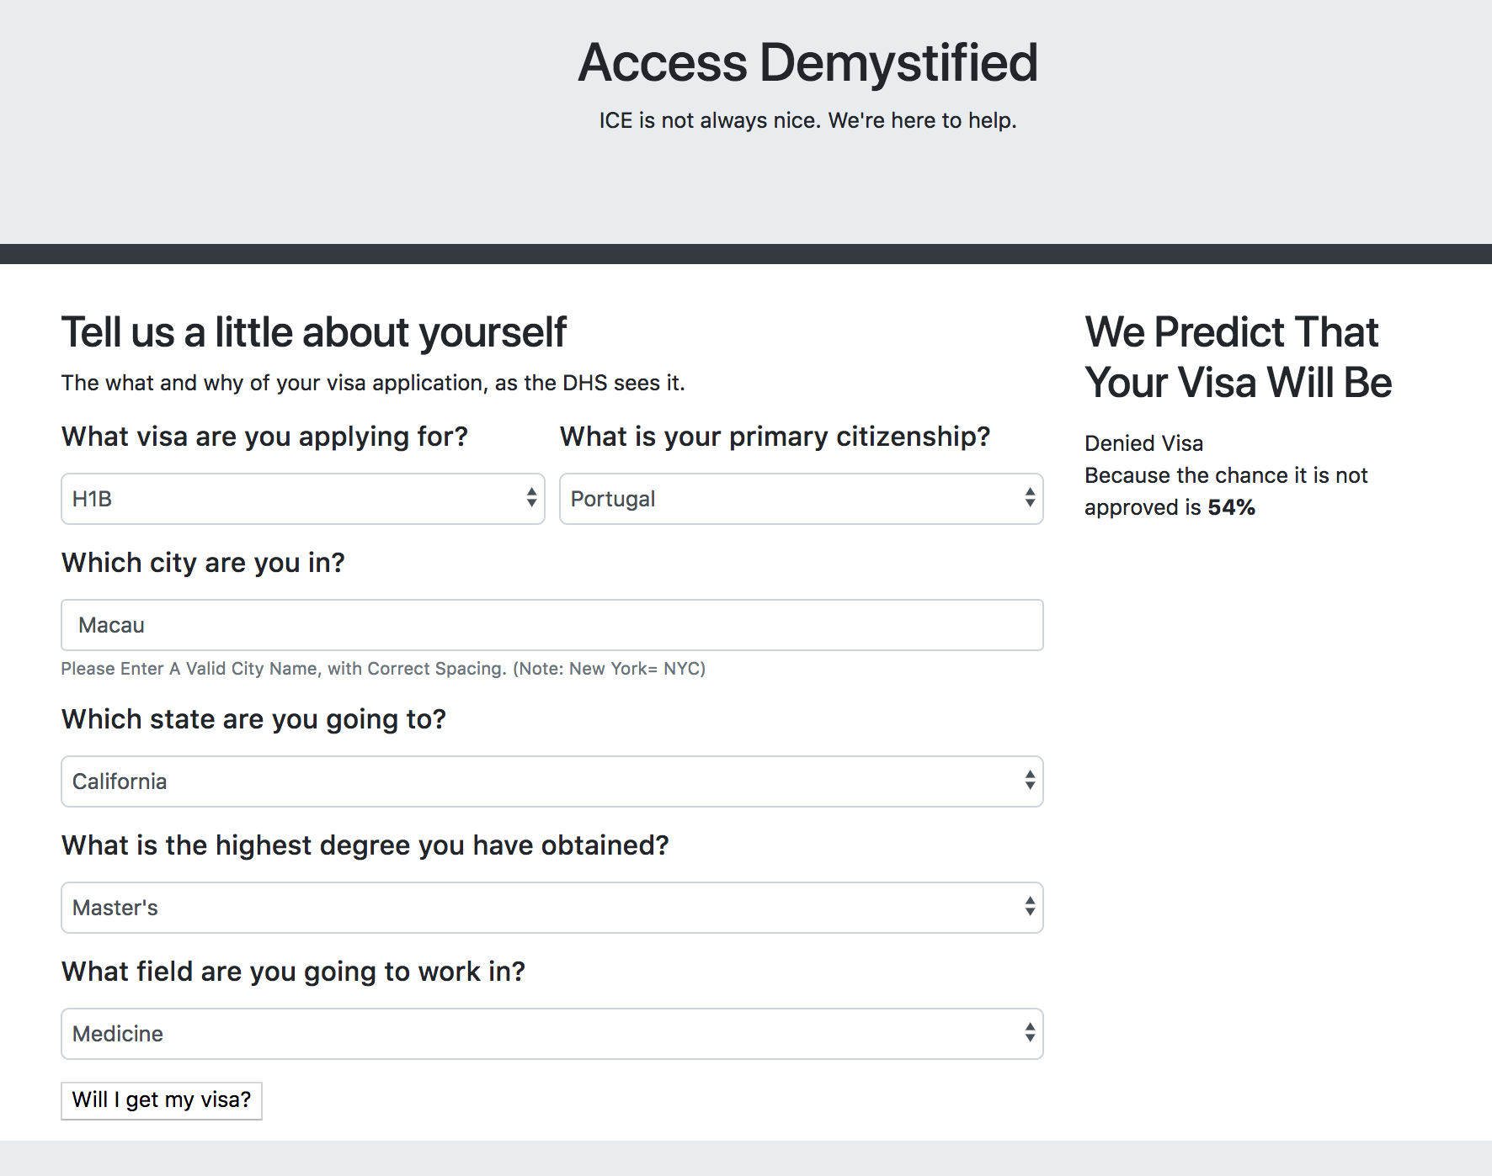

Results: Ka
Notes:
Poor Ka but, you see how easy it was for them to figure out whether or not they would get it.

Slide 8
There’s Always More to Do!
Broaden User Base
E.g. Use GoogleMaps API to Allow for More Locations
Broaden Features
E.g. Use World Factbook to Import Country Features
Update to include 2017-2018 data
Factor In Recent Policy Updates
UX Updates= Beautify Webapp
E.g. Background Images
Notes:
Part of the point was for it to be easy, but I would say that for the sake of accuracy, there needs to be

Slide 9
Questions?

